Slide 1
Analytical instrumentation Section-2, Ppt-28

Slide 2
Atomic Absorption Spectroscope (AAS)

Slide 3
Atomic Absorption Spectroscope (AAS)
A method of spectroscopy that relies on the absorption of specific frequencies of light by atoms in order to identify the chemical composition of a sample

Slide 4
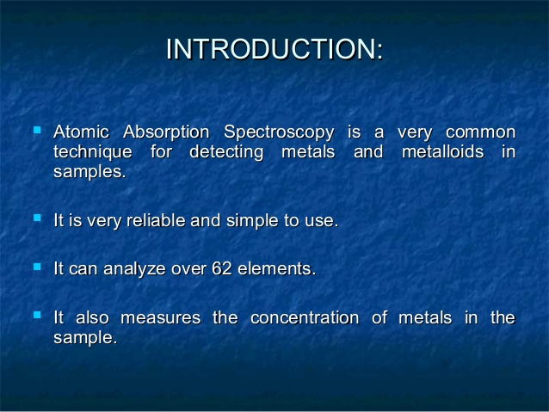

Slide 5
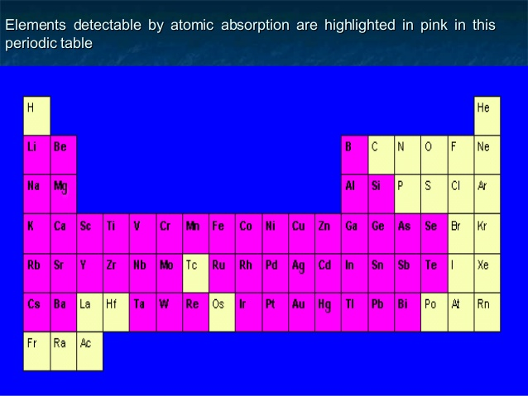

Slide 6
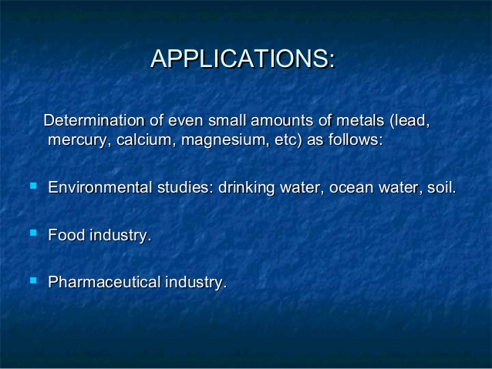

Slide 7
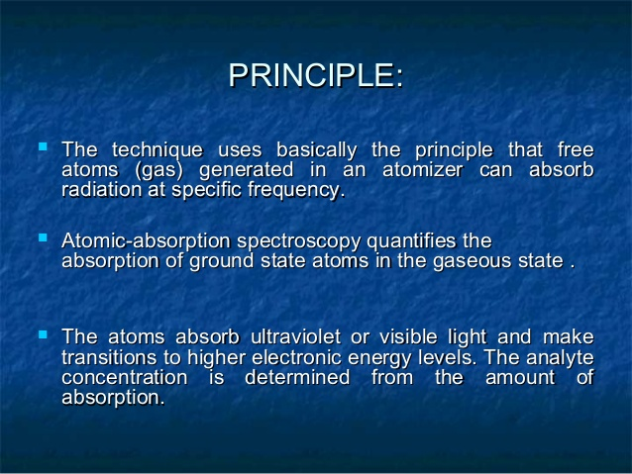

Slide 8
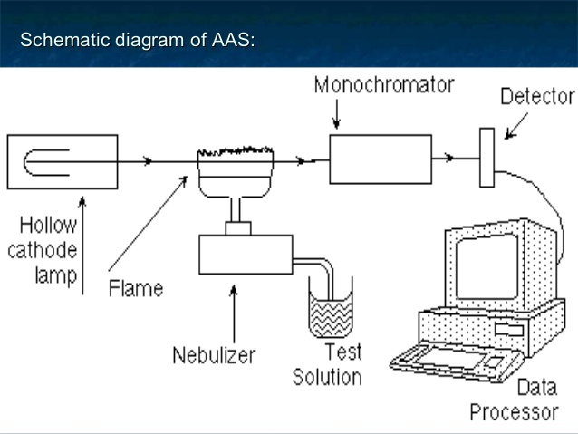

Slide 9
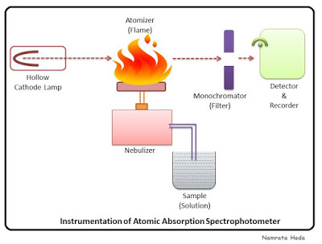

Slide 10
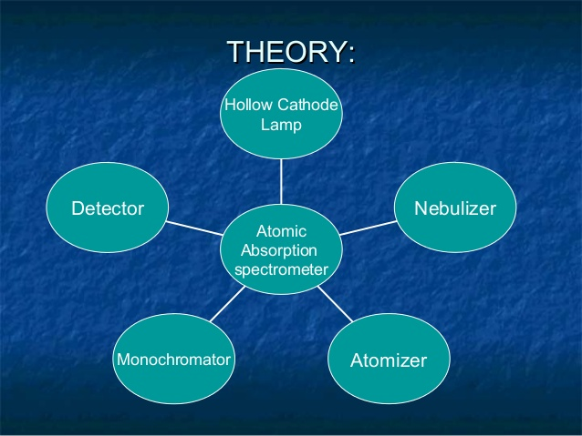

Slide 11
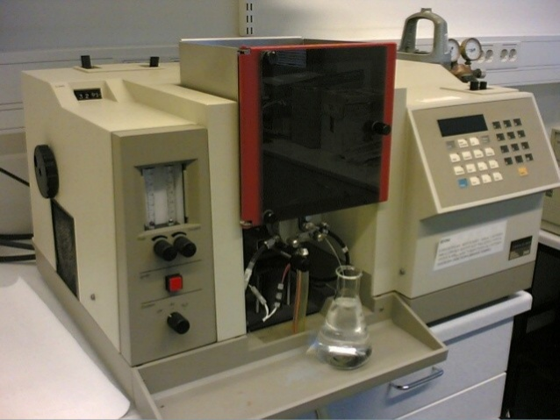

Slide 12
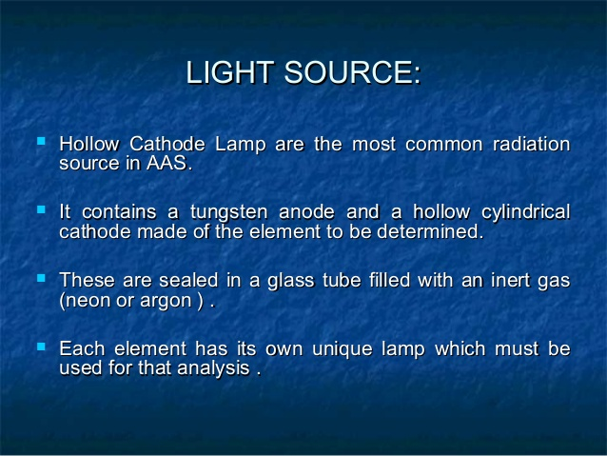

Slide 13
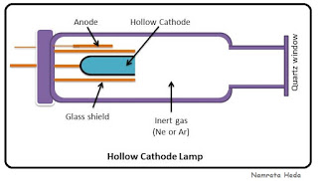

Slide 14
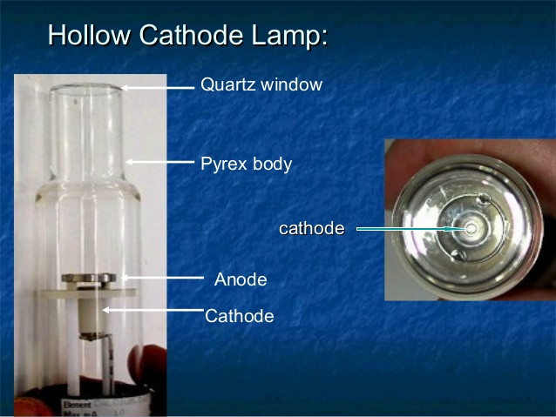

Slide 15
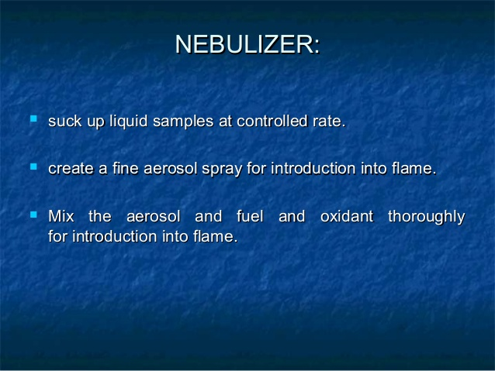

Slide 16
.
Nebulizer: It creates a fine spray of the sample for the introduction in the flame. The aerosol and the fuel and oxidant are mixed thoroughly for the introduction into the flame.
Atomizer: The elements which needs to be analysed needs to be in the atomic state. Here comes the role of atomizer. It breaks down the molecules into the atoms by exposing the analyte to high temperatures in a flame of graphite furnace (as explained in previous post, here).

Slide 17
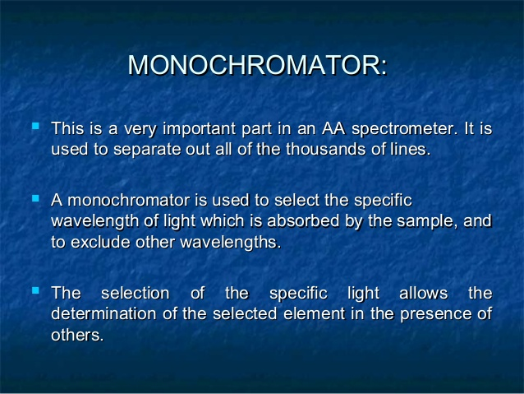

Slide 18
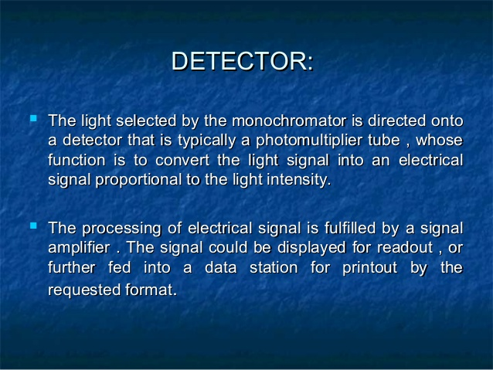

Slide 19
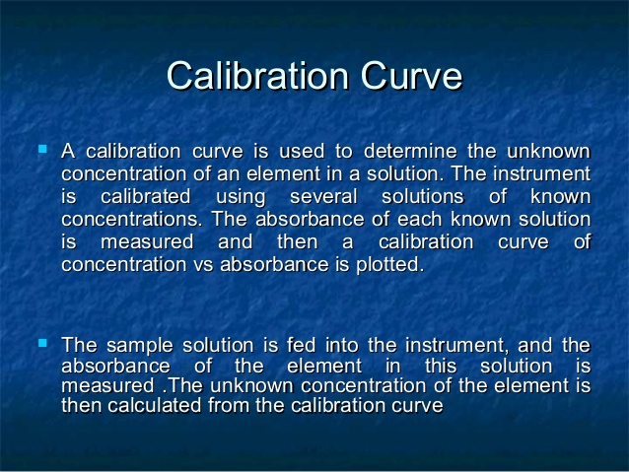

Slide 20
Which of the following is the principle of Atomic Absorption Spectroscopy? a) Radiation is absorbed by non-excited atoms in vapour state and are excited to higher states b) Medium absorbs radiation and transmitted radiation is measured c) Colour is measured d) Colour is simply observed.
Which of the following is the function of the chopper in Atomic Absorption Spectroscopy? a) To split the beam into two b) To break the steady light into a pulsating light c) To filter unwanted components d) To reduce the sample into atomic state

Slide 21
In Atomic Absorption Spectroscopy, which of the following is the generally used radiation source? a) Tungsten lamp b) Xenon mercury arc lamp c) Hydrogen or deuterium discharge lamp d) Hollow cathode lamp
In Atomic Absorption Spectroscopy, with what material is the cathode in Hollow cathode lamp constructed? a) Tungsten b) Quartz c) Element to be investigated d) Aluminium

Slide 22
Which of the following is the function of the atomiser in the emission system of Atomic Absorption Spectroscopy? a) To split the beam into two b) To break the steady light into pulsating light c) To break large mass of liquid into small drops d) To reduce the sample into atomic state.
At what pressure should the gases in the sealed tube be maintained in the Hollow cathode lamp? a) 1 to 5 torr b) 20 to 30 torr c) 40 to 50 torr d) 50 to 55 torr

Slide 24
Thank you

